Slide 1
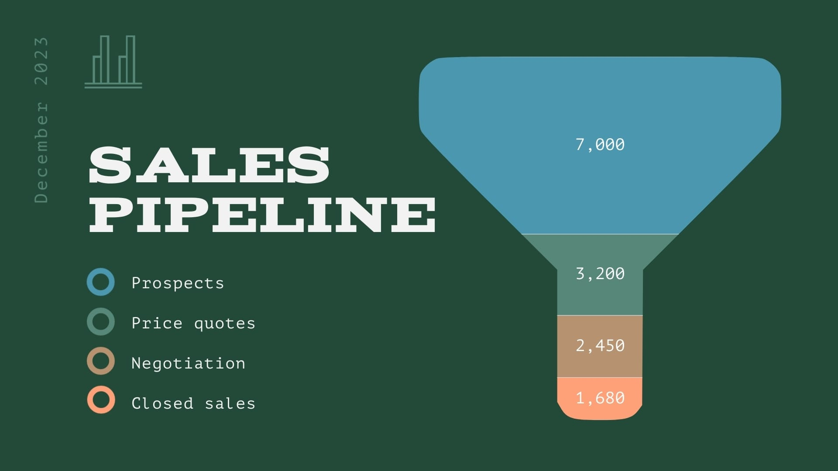
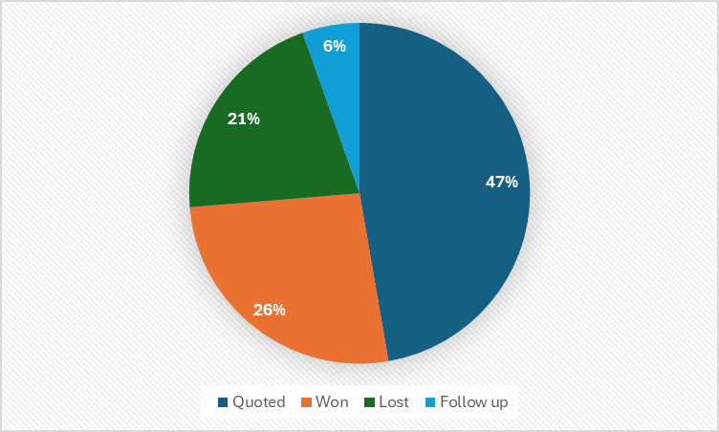
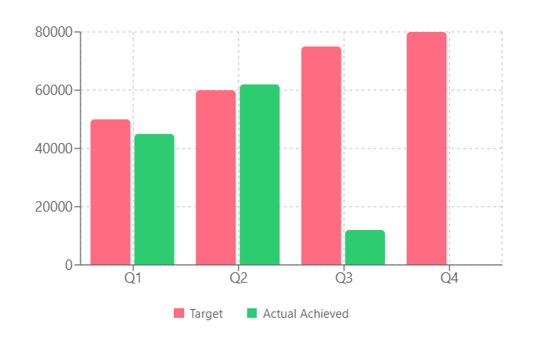
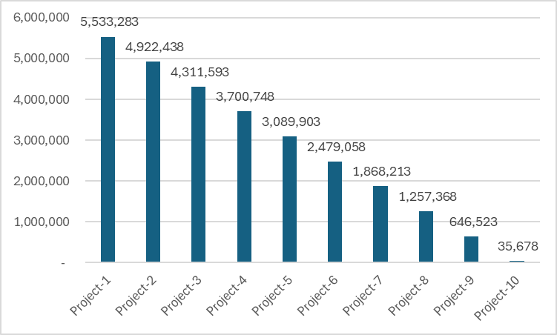
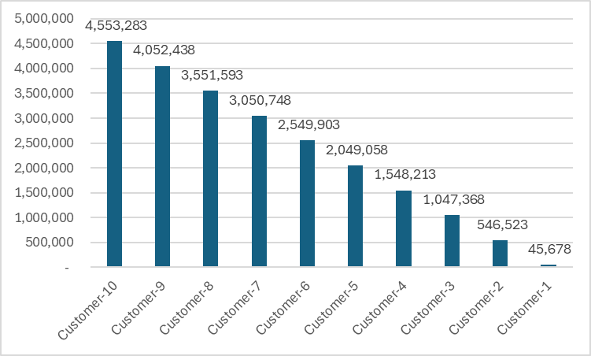
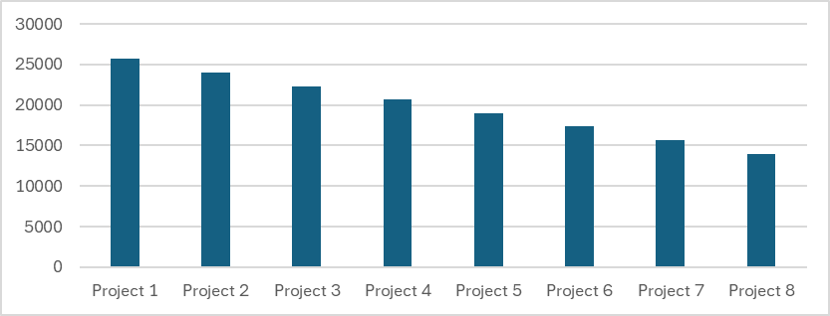
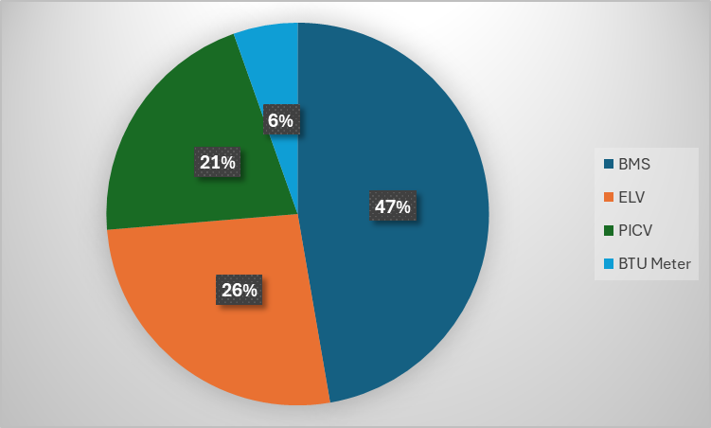
Year
Company Name
Division Name
SE/QS/EE/TE/SM
1
2026
All
All
All
Job Booked:
Prospect
Prospect
Achieved
84%
123,456
Actual
Wining
rate
Won
123,456
145,654
Target
25%
84%
84%
84%
84%
Lost
524,656
Q1
Q2
Q3
Q4
Losing
rate
123,456
123,456
123,456
123,456
84%
Quoted
145,654
145,654
145,654
145,654
145,654
Target Vs Actual
Top 10 Projects booked
Top 10 Customer’s job booked
Category
Selection
Item name
Customer
Customer - 1
All

Slide 2
Low Chance (25%)
0
50-50 Chance (50%)
0
Medium Chance (75%)
7.9k
56.5k
High Chance (90%)
5.6k
Very High Chance (99%)

